Slide 1
Multi-Server Security Architecture
using DMZ
Subtitle: Secure Implementation of Web, Database, and Mail Servers with Monitoring and Intrusion Detection
Presented by: Komal vede
Institute: Sunbeam Institute of Information Technology, Pune

Slide 2

Introduction:
Today, every organization needs a safe and separate network system to protect its data.
A DMZ (Demilitarized Zone) helps add an extra layer of security between the internal network and the outside internet.
In this project, we have created a multi-server setup inside a DMZ that includes security tools, monitoring systems, and intrusion detection to keep the servers and data safe from attacks.

Slide 3
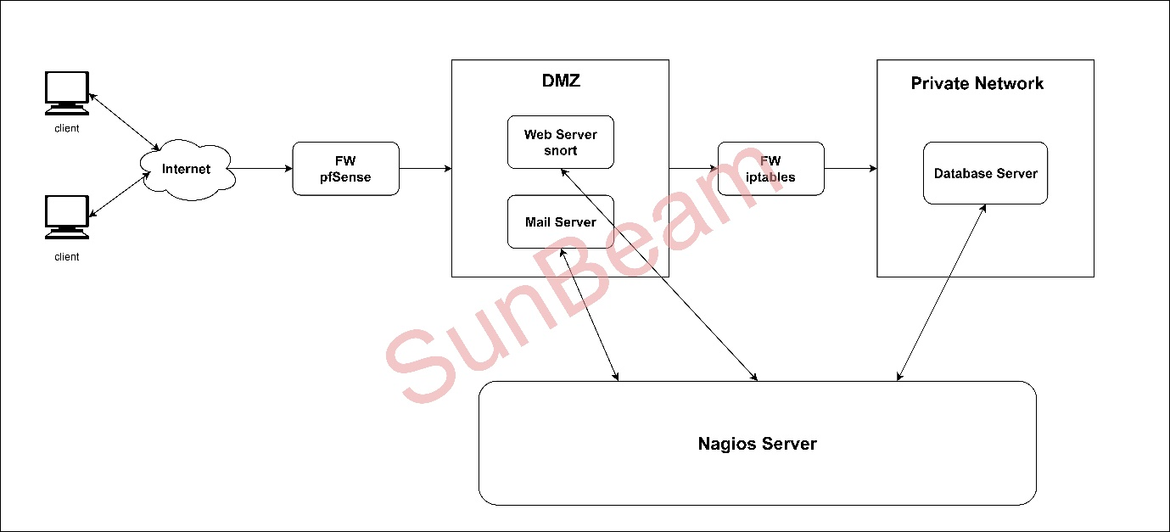
Network Architecture

Slide 4
Network Architecture Overview
The project infrastructure was designed using a DMZ-based layered architecture to separate public-facing services from the internal private network. The key components included:
Clients (Internet-facing)
pfSense Firewall – controls incoming/outgoing traffic to the DMZ.
DMZ Zone – contains: Web Server (Apache2 + Flask App + Snort) and Mail Server (Postfix + Dovecot + Roundcube)
iptables Firewall – secures access to the private network.
Private Network – hosts Database Server (MySQL).
Nagios Server – monitors all critical servers and services.

Slide 5
Project Objective
Deployed 3 servers: Web, Database, Mail
Configured Flask-based web application
Setup mail server with webmail access
Monitored the servers and services using Nagios XI
Implemented intrusion detection using Snort
Harden servers with fail2ban, iptables, pfSense

Slide 6
Tools & Technologies Used
OS: Debian 12
Web: Flask, Apache2/Nginx
Database: MySQL
Mail: Postfix, Dovecot, Webmail (Roundcube)
Monitoring: Nagios XI
IDS: Snort
Firewall & Security: pfSense, fail2ban, iptables

Slide 7
Web & Database Server Setup
Installed MySQL on DB server and setup the Flask App on Web server
Created database
Cloned Flask app: https://github.com/sunbeam-ditiss/KartvyaPath-Project.git
Configured web server to connect to database
Verified application on http://192.168.80.166:5000

Slide 8
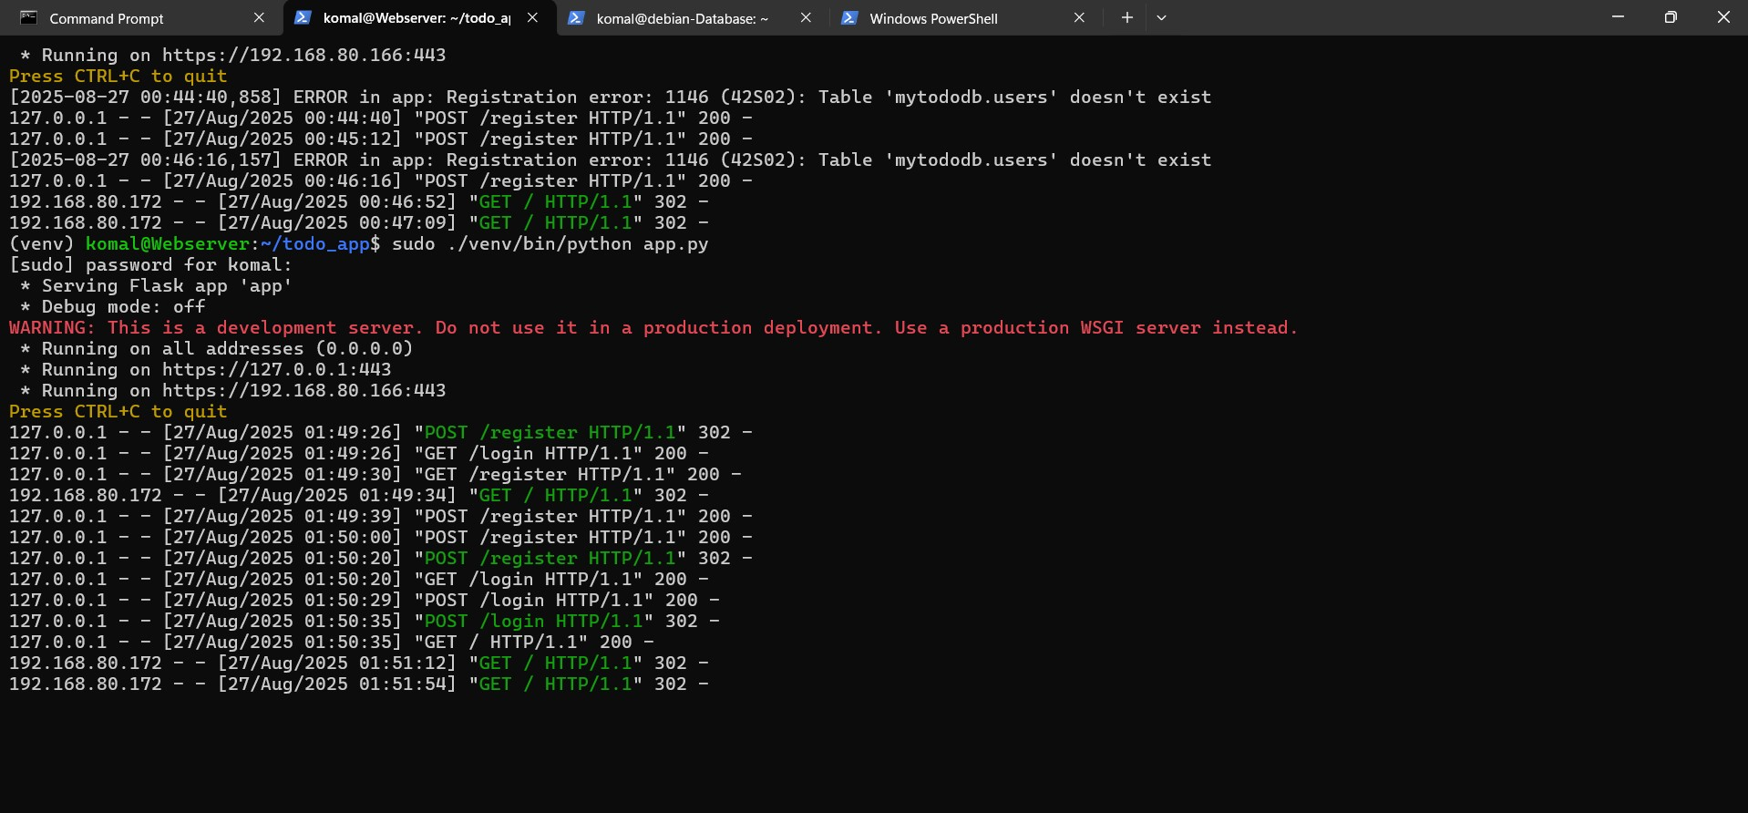

Slide 9
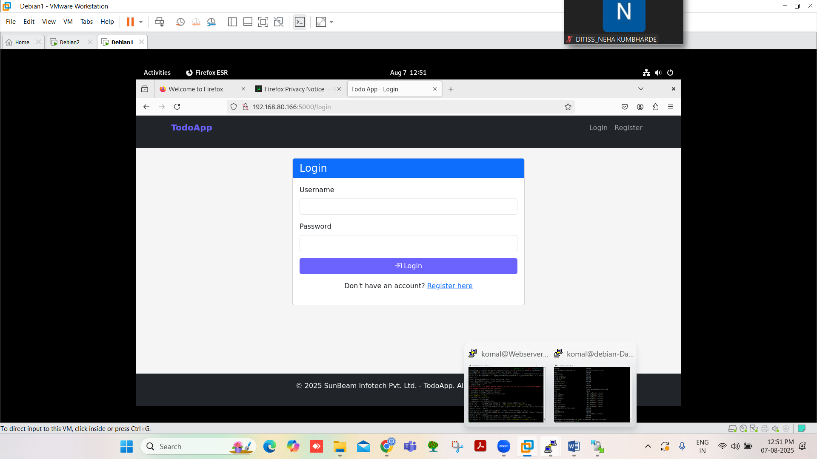

Slide 10
HTTPS & SSL
Added domain todo.sunbeam.local in /etc/hosts
Generated self-signed certificates:
/etc/ssl/todo/todo.key
/etc/ssl/todo/todo.crt
Configured Flask to use SSL:
app.run(host='0.0.0.0', port=443, ssl_context=(cert, key))
Access via https://todo.sunbeam.local

Slide 11
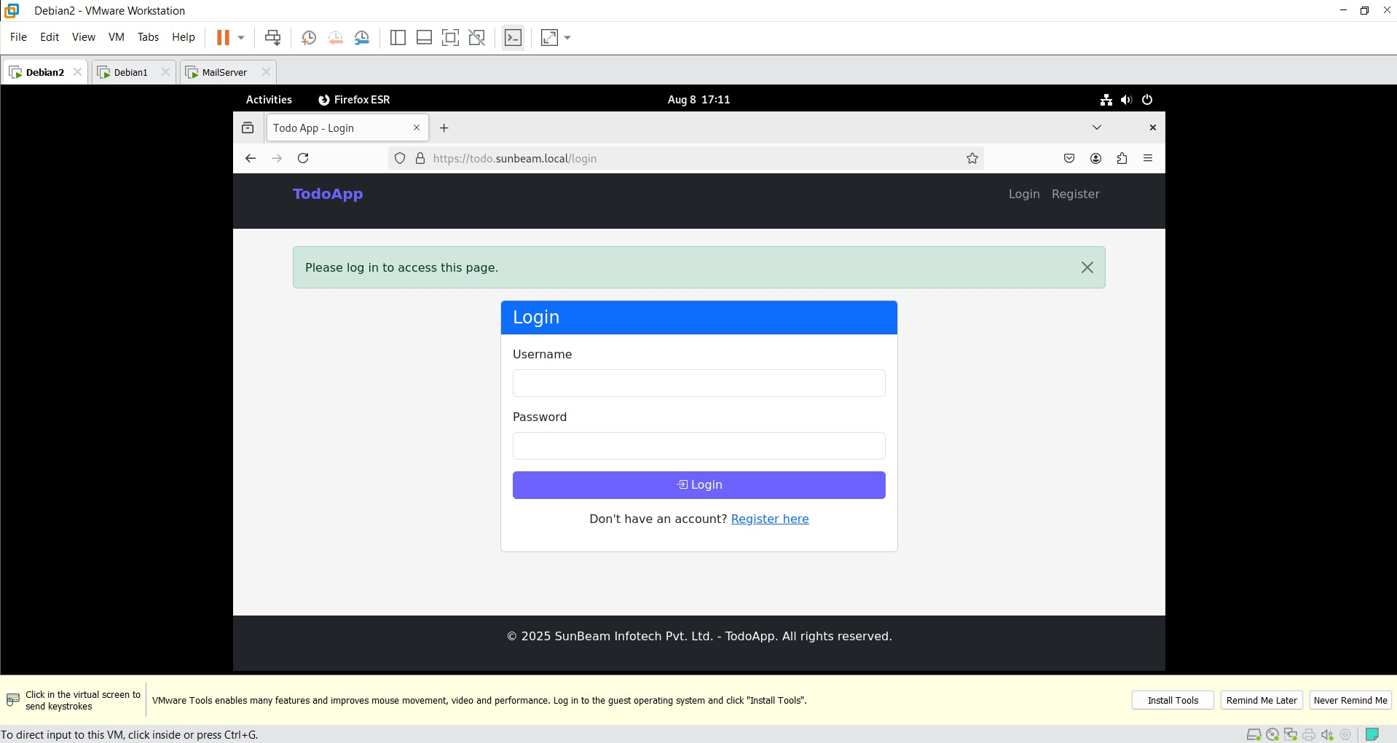

Slide 12
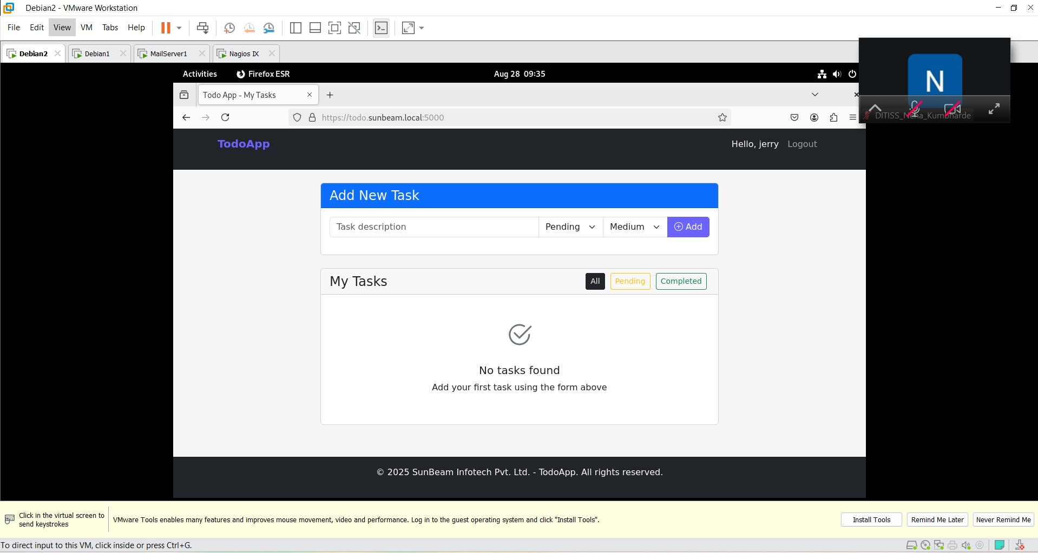

Slide 13
Mail Server Installation
Created a Third VM of Debian12 = Mail Server
Installed Postfix & Dovecot on Mail Server
Configured domain: sunbeam.local
Created users: user1 & user2
Verified mail sending/receiving

Slide 14
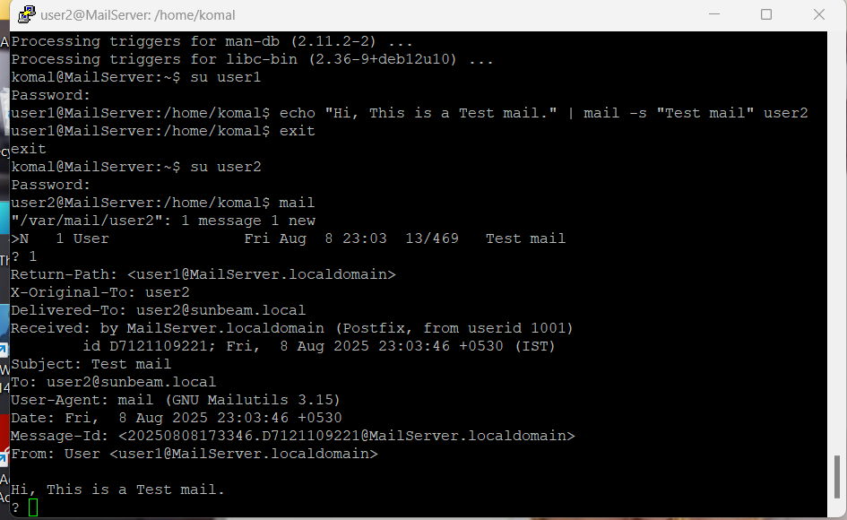

Slide 15
Webmail Setup
Installed Roundcube webmail
Configured Apache virtual host for mail.sunbeam.local
Access webmail via browser
Login with user1 & user2

Slide 16
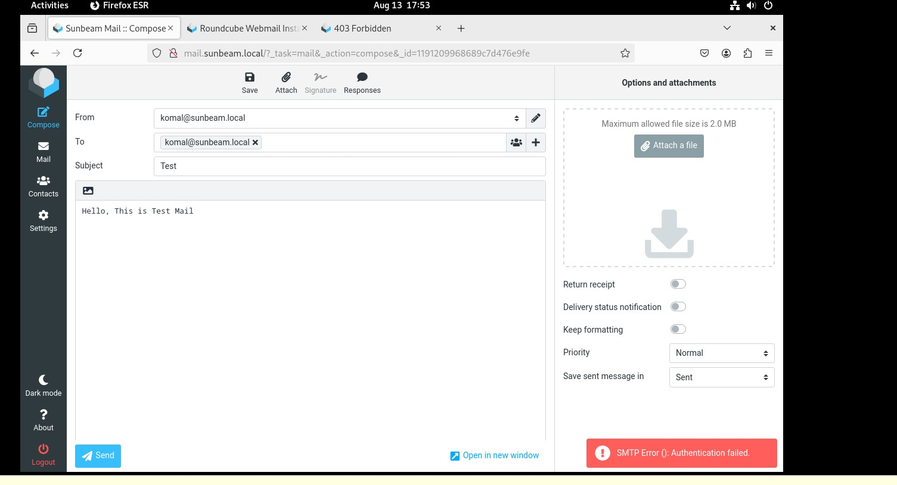

Slide 17
Monitoring with Nagios XI
Installed Nagios XI
Monitored services:
Web: HTTP, HTTPS, Apache2, CPU, Memory
Mail: SMTP, IMAP, POP3, CPU, Memory
Configured alerts to sunbeam.local email

Slide 18
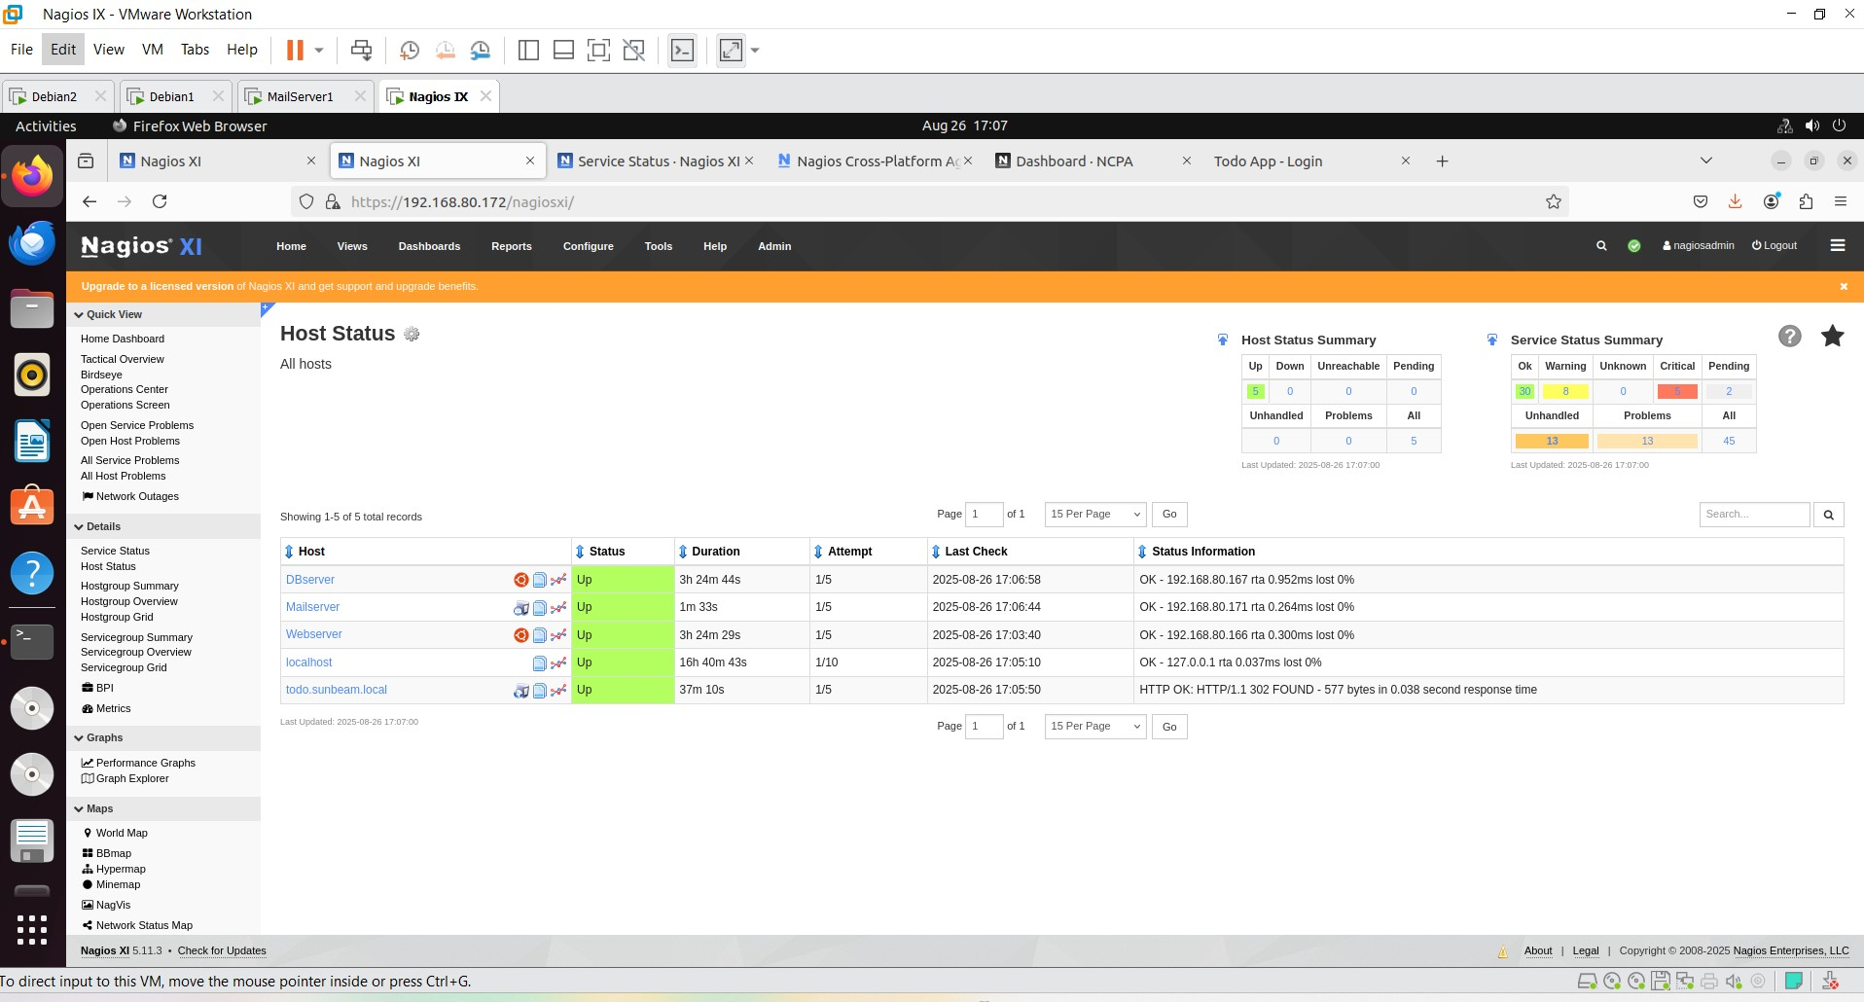

Slide 19
Snort IDS Setup
Installed Snort on Web Server
Created rules:
SYN Flood
Ping Flood
Ping of Death
Verified detection using hping3 & ping

Slide 20
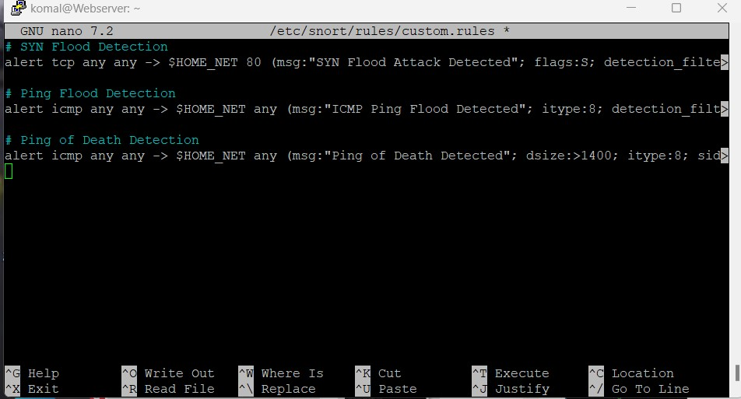

Slide 21
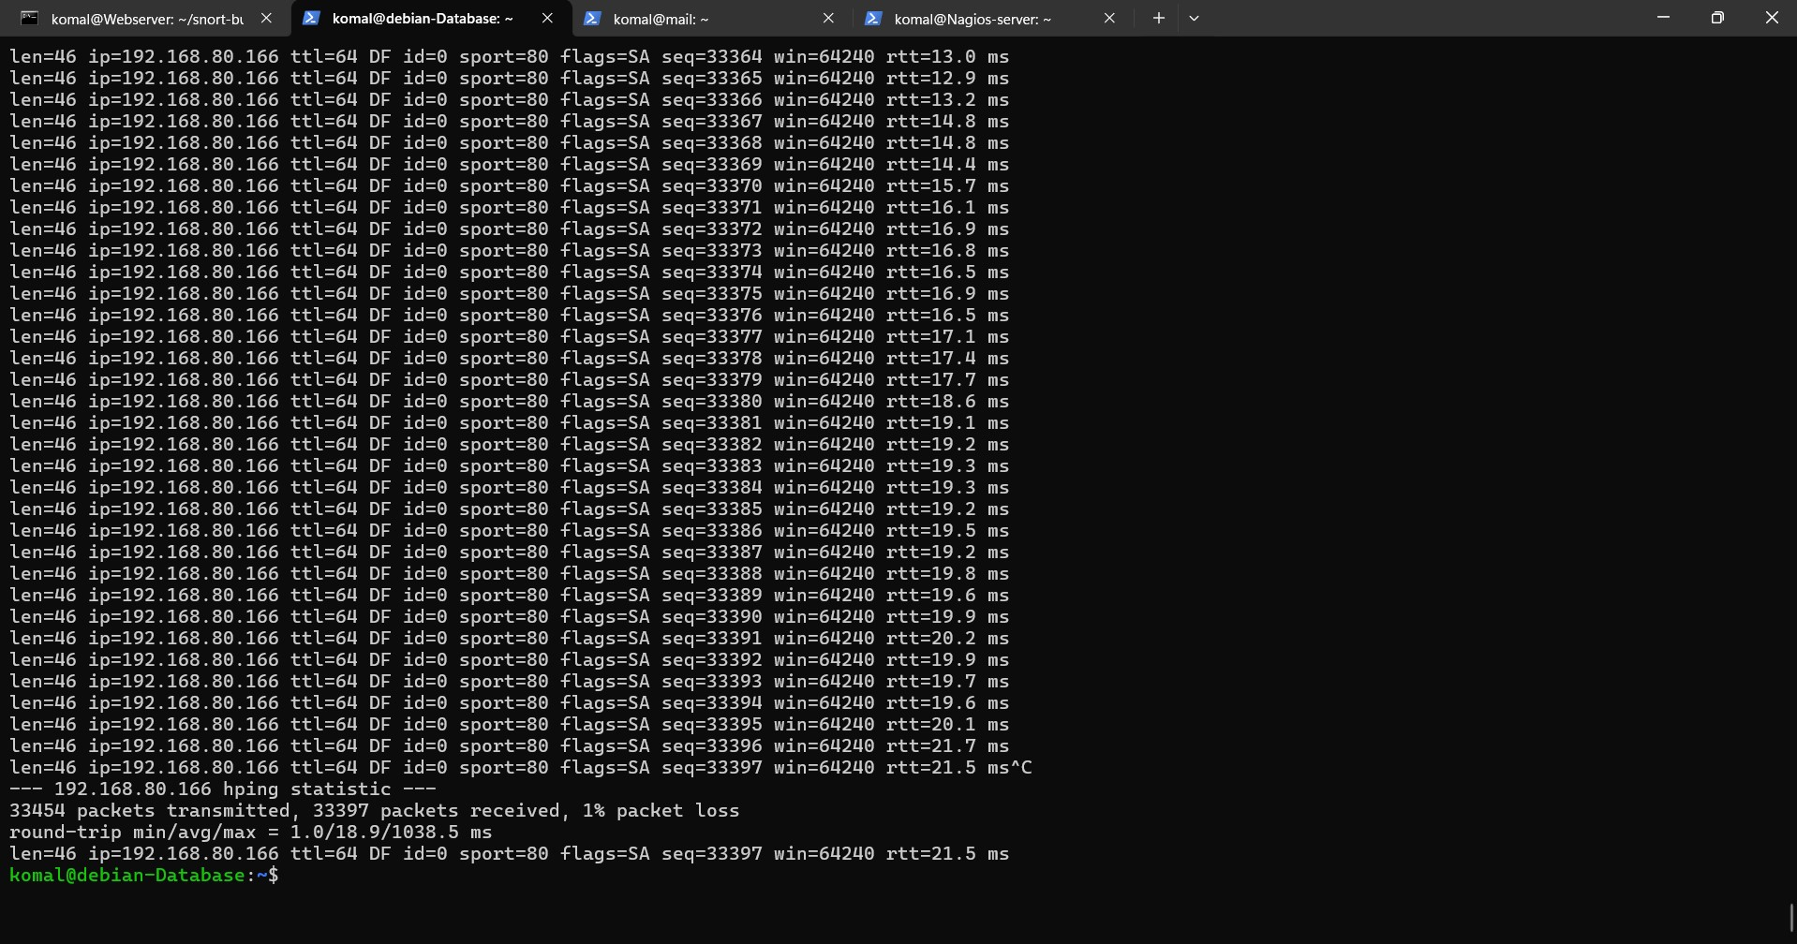
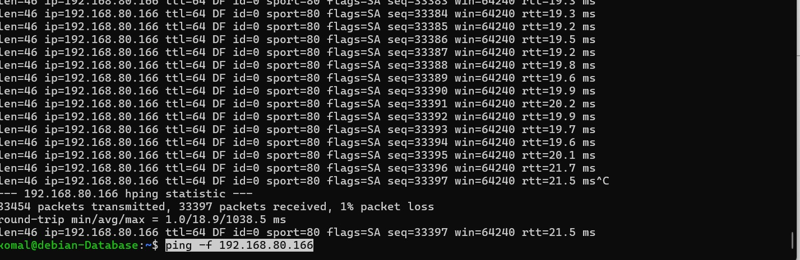
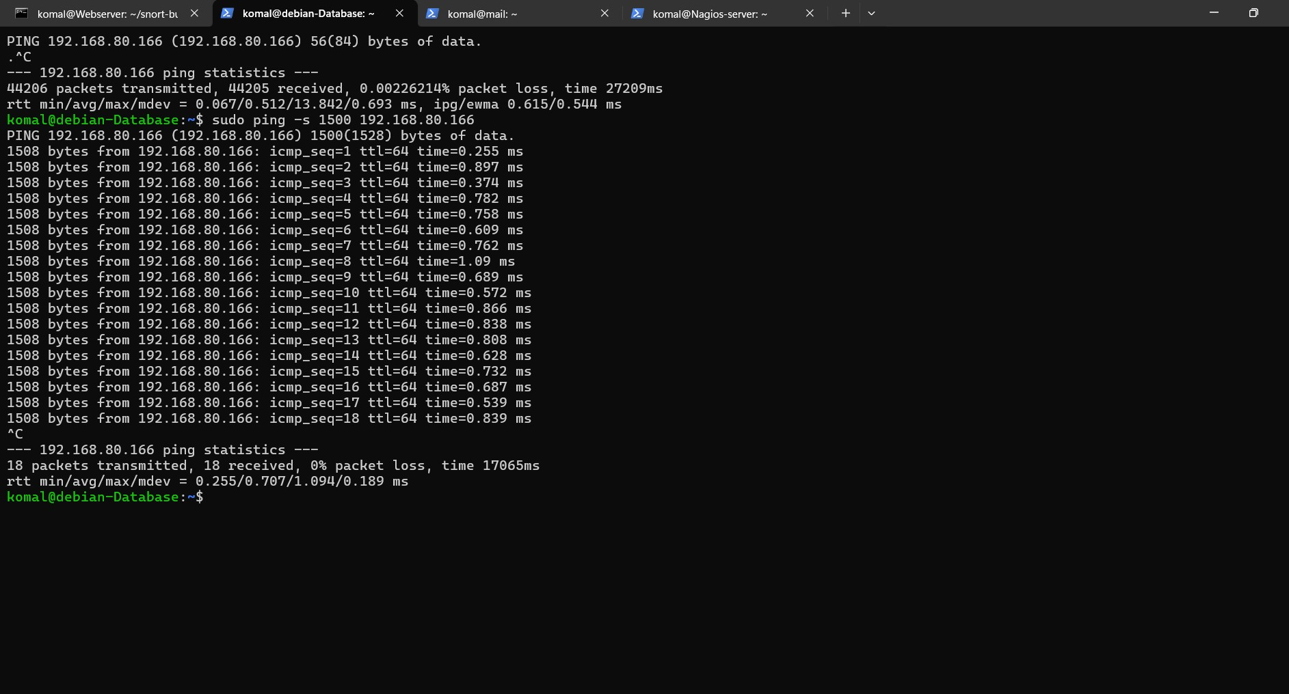

Slide 22
System Hardening & Firewall
Installed Fail2ban on all servers
Configured iptables on DB server to allow only web server access
Installed & configured pfSense firewall
Verified SSH, HTTP/HTTPS, DB access restrictions

Slide 23
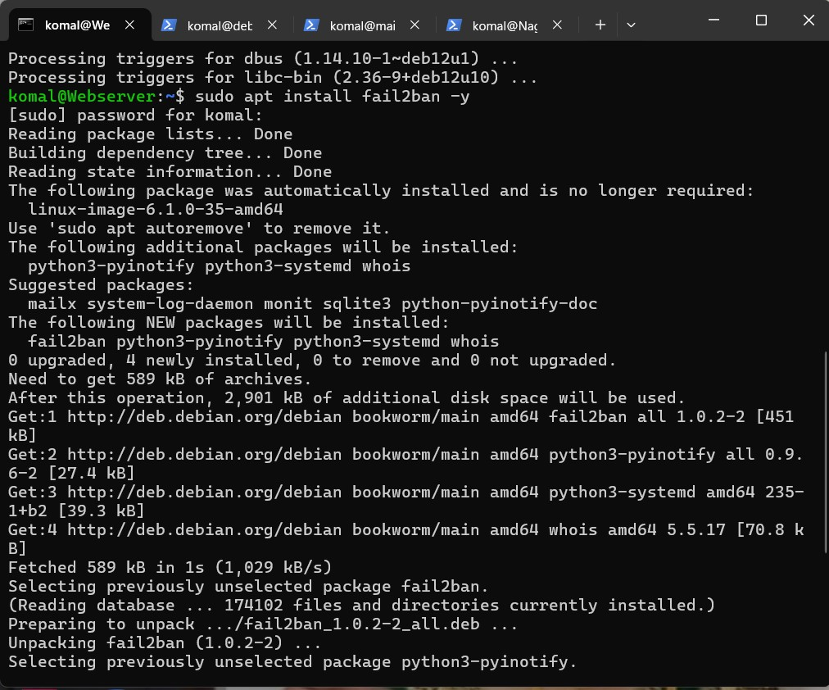
1-WebServer

Slide 24
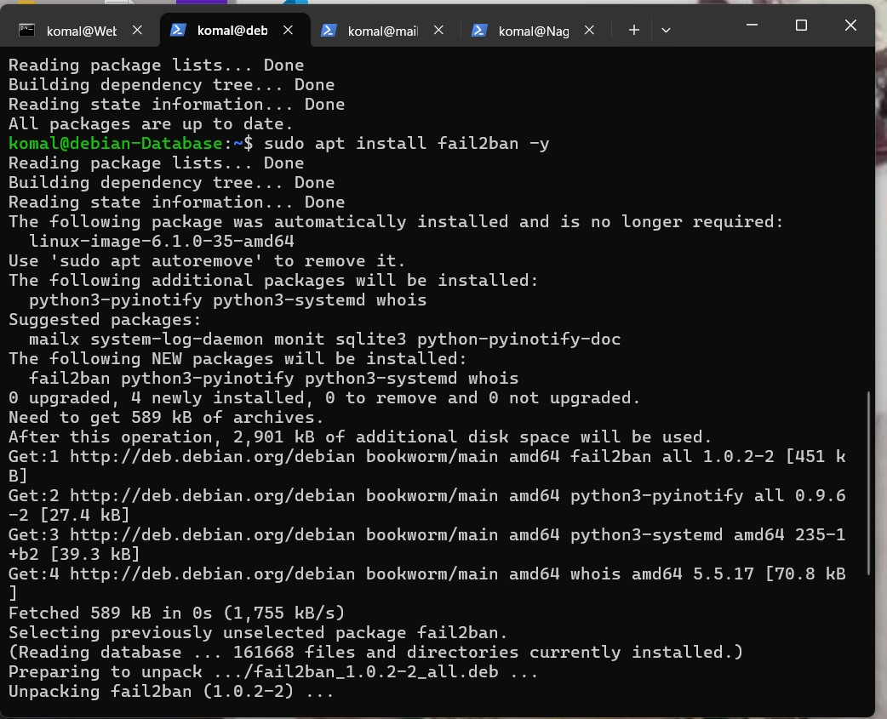
2-DBServer

Slide 25
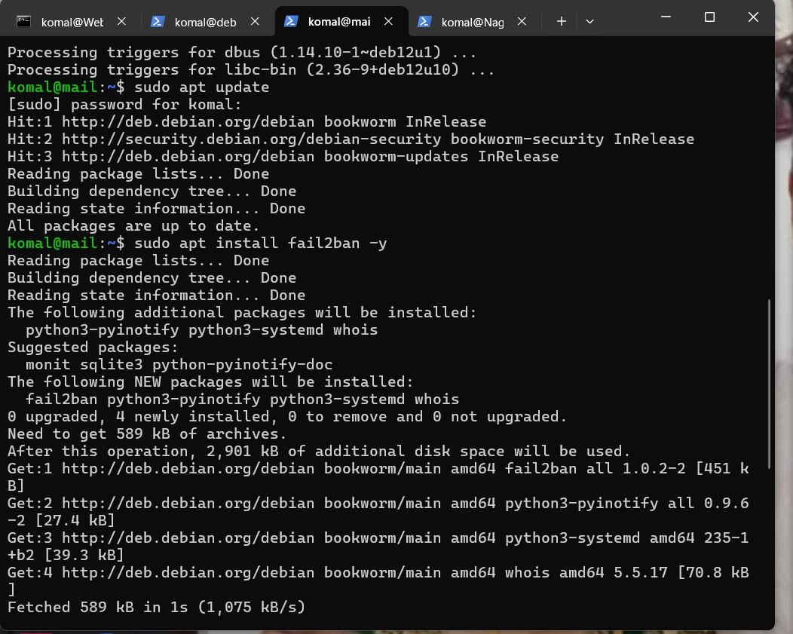
3-MailServer

Slide 26
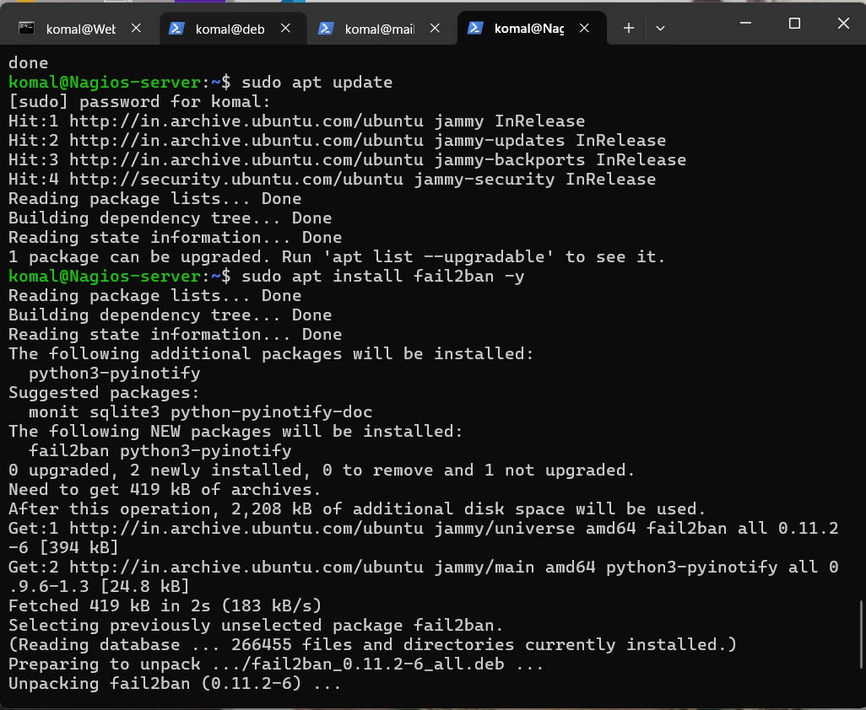
4-Nagios XI

Slide 27
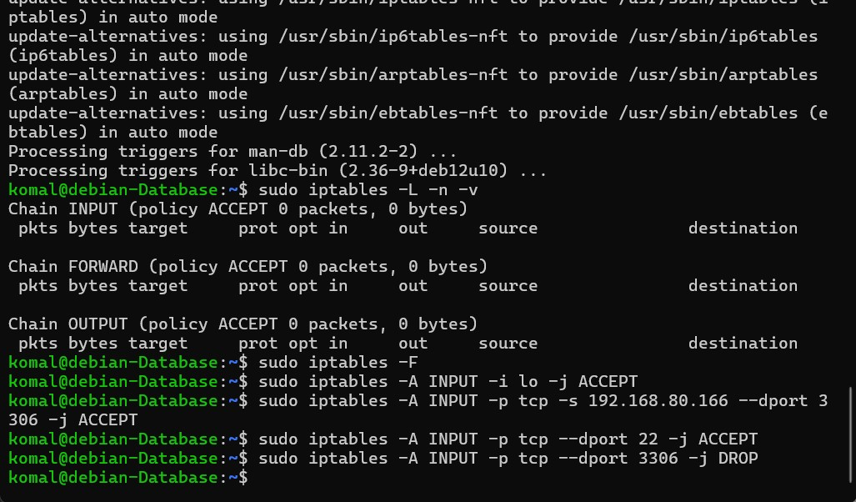
5- iptables

Slide 28
Conclusion
Successfully deployed 3-server lab environment
Implemented monitoring, alerts, and intrusion detection
Hardened servers with fail2ban, iptables, and pfSense
Lab demonstrates real-world network deployment and security practices

Slide 29
THANK YOU

